Slide 1



How to Make State Management Work for You with Redux and Redux Toolkit Michelle Moudy, SAP

Slide 2


Repo link:
https://github.com/SAP-samples/devtoberfest-2021/tree/main/topics/Week6_Frontend/Redux-Example
Redux DevTools Extension:
https://github.com/zalmoxisus/redux-devtools-extension

Slide 3



What is Redux?

Slide 4


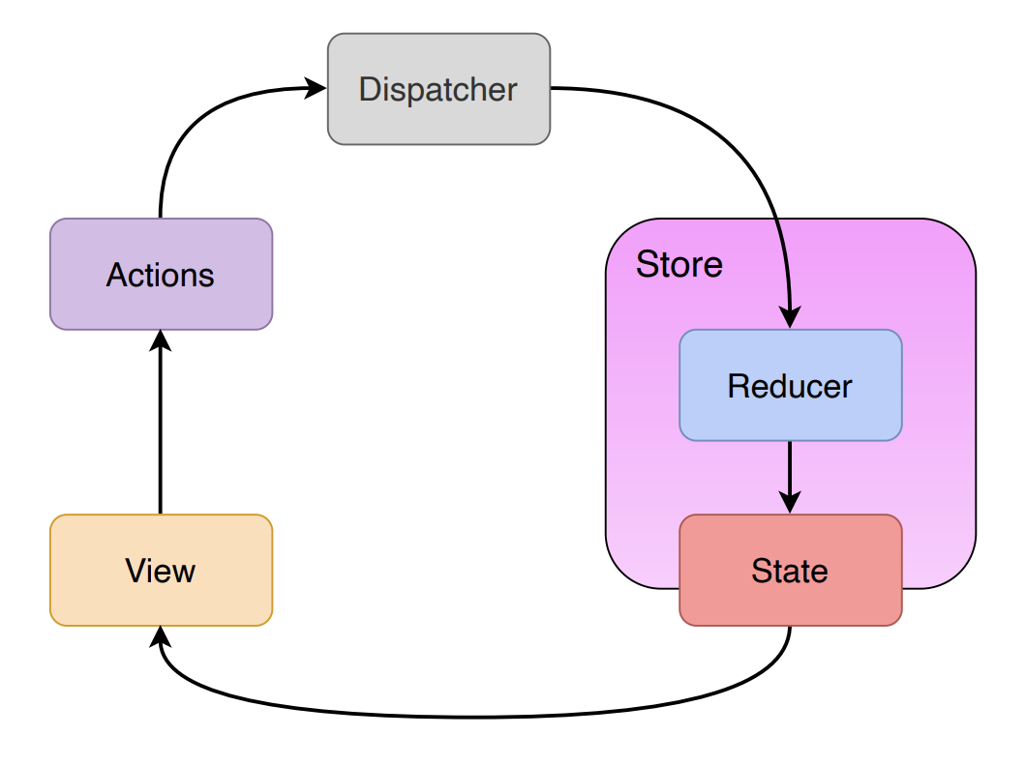


Slide 5
Why would you use Redux?

Slide 6
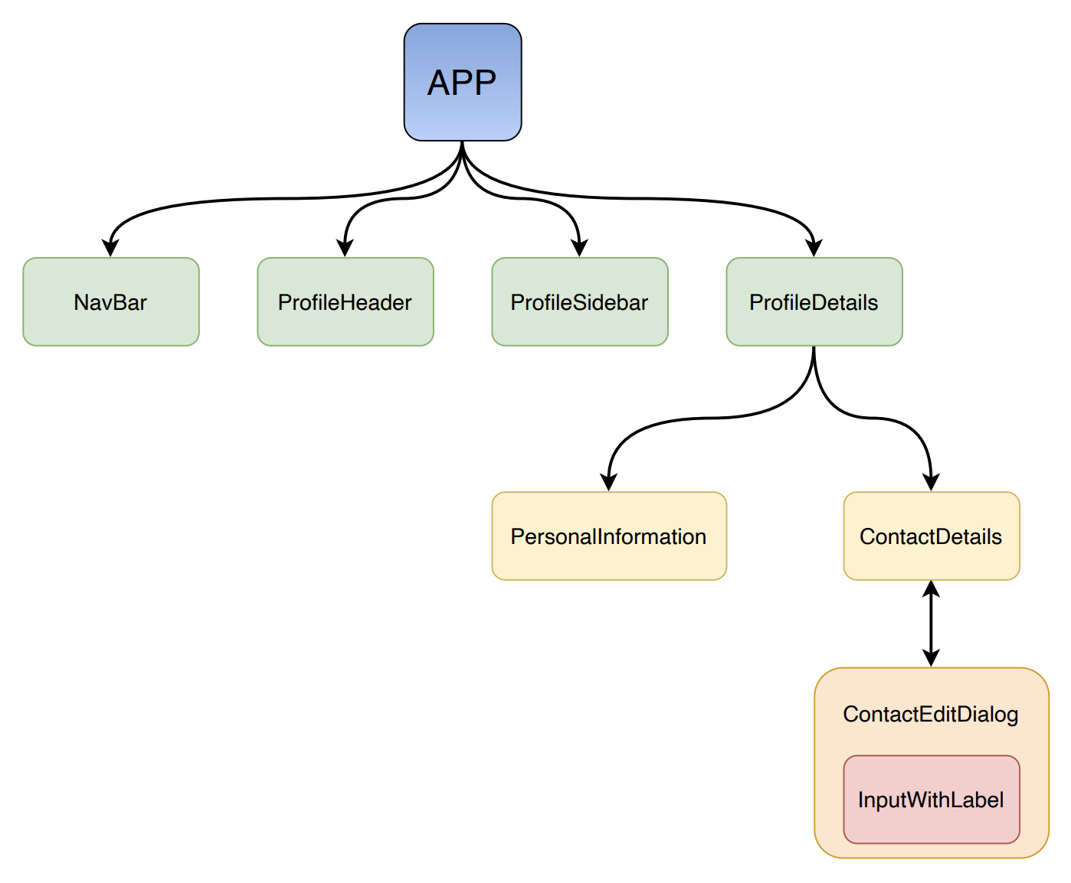


Slide 7
How do you use Redux?

Slide 8



Contact information:
Michelle Moudy
Software Developer
Michelle.Moudy@sap.com

